Slide 1
Mission Rosie Trimester 1
Dak Cheung Cheng

Slide 2
Initial Ideas and Information
This section records my original thoughts and plans…some parts may be updated later on
Outdated information will be marked with an asterisk(*)
Schematics will be continuously updated, refer to the latest version for the latest information

Slide 3
Initial Housekeeping (17 September 2018)
I had to look at previous documentation that other people have left behind to see what has been done and what needed to be figured out
Not a lot of things done…Rosie is far from working
I noted that there were many sensors that have not been implemented including :
Motor encoders
IR distance sensors
The wiring also had to be cleaned up…
Some parts could be upgraded, like the Arduino/Arduino WAVE shield combo with a Raspberry Pi/Voice HAT
Motors were not wired up and only WAVE shield was attached when I embarked on the project, so I decided to take everything apart and start from scratch

Slide 4
The Grand Plan (20 September 2018)
Make Rosie a versatile robot that can do anything based on voice commands
Dance
Patrol the hallways
Facial and Voice Recognition
Create a more direct path for expandability in the future
Future students will not need to wreck anything, just add more code…
Parts upgrade will involve minimal effort and little rewiring

Slide 5
Making things neat
I intend to make a control board consisting of a Google AIY Voice HAT on a Raspberry Pi 3B and an Arduino Due connected together with I2C.
Raspberry Pi with the Voice HAT is for voice recognition and displaying an image on the monitor.
Why Raspberry Pi 3B? It’s a reliable, powerful, and relatively recent single board computer that has been proven to work with the Voice HAT. It can also do vision processing.
Why Voice HAT? Provides an easy way of integrating voice recognition. Plus it has a built-in speaker amp capable enough to drive the speaker at a respectable volume, compared to the Arduino and the WAVE shield.
*Arduino Due is for motor control and sensor interface.
Why Due and not Uno? Because 2 > 1 (:P). And the Uno doesn’t have enough pins to account for all the sensors and motors. Plus the Due is a 3.3v board- so is the Pi, so I2C communication wiring doesn’t require level shifters

Slide 6
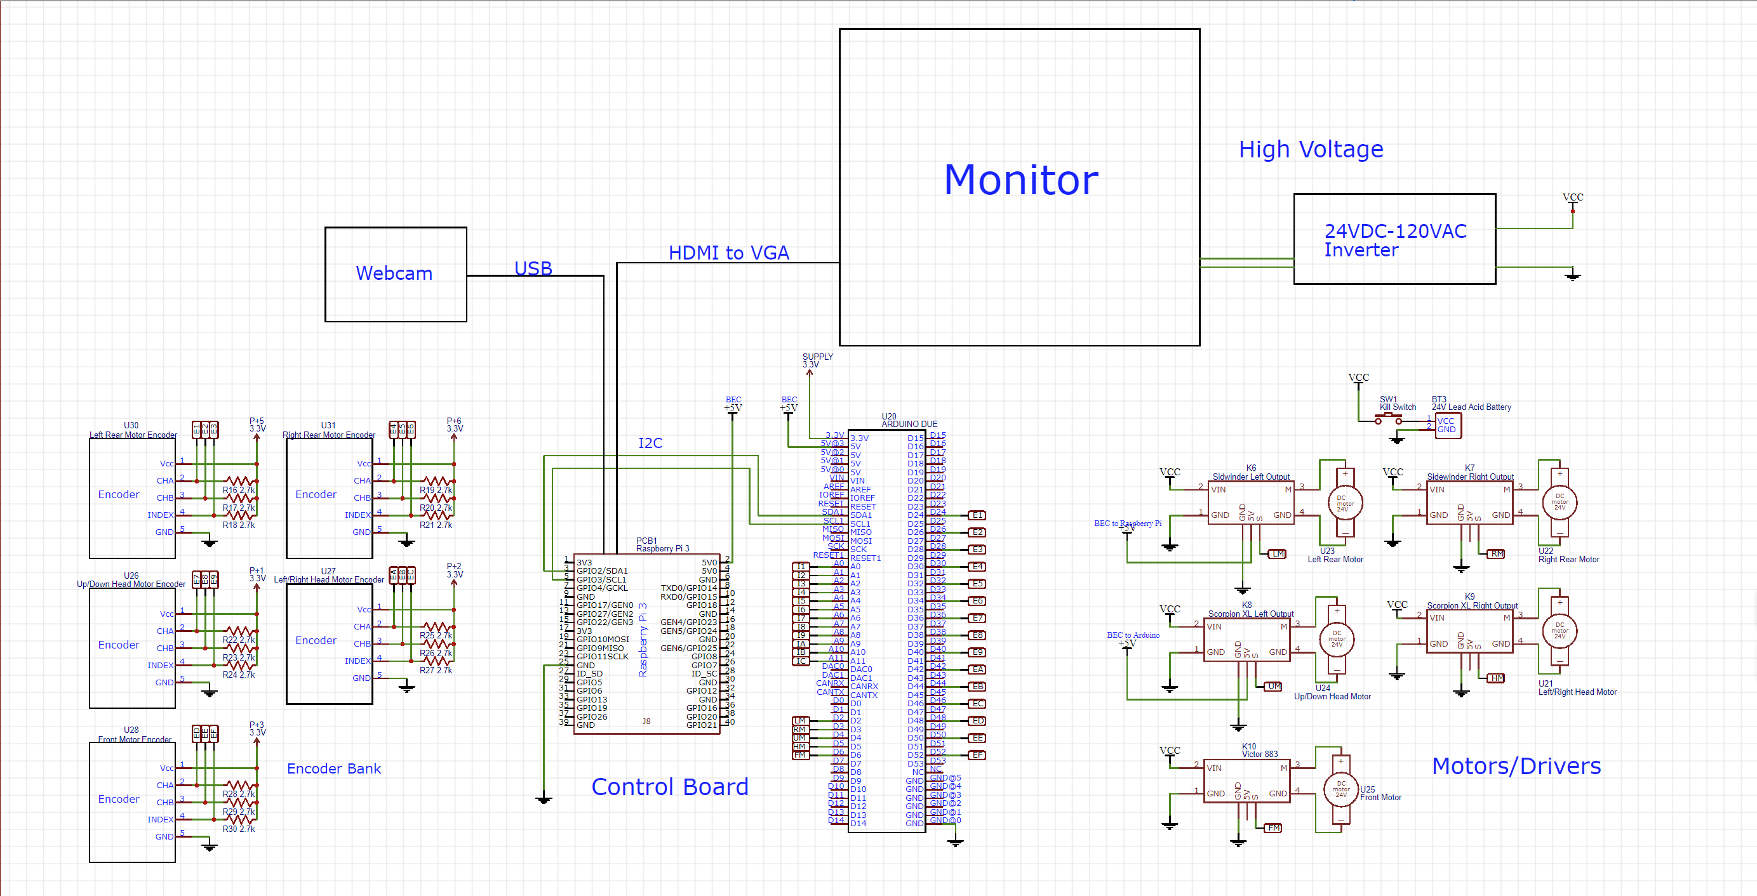
Schematics v1 (based off of initial observations) (24 September 2018)

Slide 7
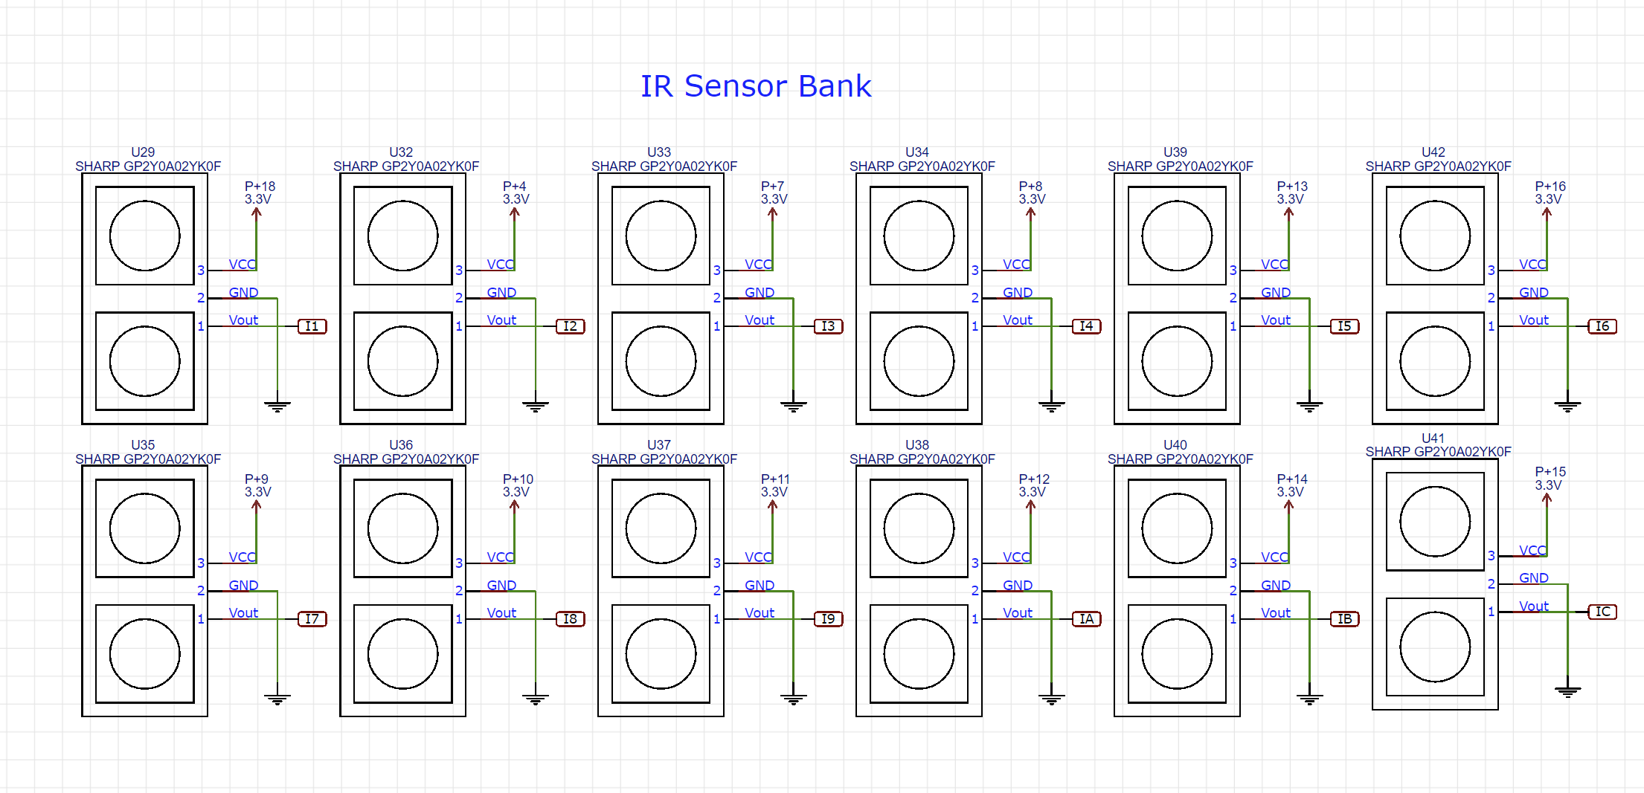
Schematics v1 continued

Slide 8
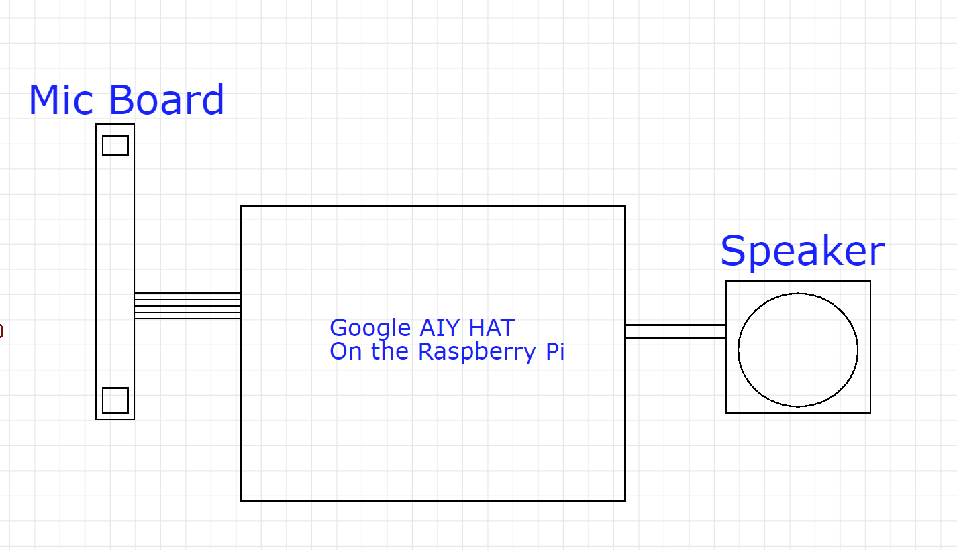
Schematics v1 continued

Slide 9
Old Computer and Monitor
The only use of the old computer inside Rosie was to put an image on the monitor, and that could easily be done with a Raspberry Pi.
Otherwise, the computer was just taking up valuable space… so I took it out.
I will need a HDMI to VGA converter to wire the Pi’s HDMI to the monitor’s VGA.
*I will use a 24v-120v inverter to power the monitor.

Slide 10
Driving the motors
Number one priority was movements…if Rosie cannot move, then it is a gigantic paperweight/ugly mannequin.
Sidewinder ESC (Electronic Speed Controller) was configured to a tank drive based on the datasheet here: http://www.robotpower.com/downloads/RobotPower_Sidewinder_quickstart.pdf
I scratch-wrote new code to drive the motors
Instead of using the Servo.write() function, I used Servo.writeMicroseconds() for greater control
Motor datasheet: http://hades.mech.northwestern.edu/images/3/3c/Pittman-ELCOM-SL-4443S013.pdf
*Battery Eliminator Circuit (BEC) from the ESC provides power to the Raspberry Pi and Arduino Due

Slide 11
Wiring the front motor
I found a Victor 885 motor controller
Based on this datasheet: http://www.robotmarketplace.com/products/images/IFI-883-885-Manual.pdf, I calibrated and powered the front motor.
Speed was completely off compared with the Sidewinder—turns out that problem cannot be fixed, so instead of setting a specific pulse, I can set a specific number of rpm and use a PID controller to compensate for the differences in speed.

Slide 12
Encoders
The encoders provided are 3 channel 500 cpr encoders with a channel A, channel B, and index pin which goes high every full revolution.
Datasheet: http://www.farnell.com/datasheets/20563.pdf
Using pin change interrupts can enable me to catch every pulse
I can make Rosie go straight by calculating the RPM based on the encoders and using a PID control loop to keep both motors running at a set RPM
*Each output of the encoder needs a 2.7 kiloohm pull-up resistor (note that it is pulled up to 3.3v, as the Arduino Due operates on 3.3v logic)
Update, November 27 2018, I may not need an Arduino Due, I can do everything with an Arduino Uno, and encoders may be non-existent due to new motors

Slide 13
Head
There are two motors that control the x and y movements of the monitor (head)
The motors will be driven by a Scorpion XL motor controller, datasheet here: http://www.robotcombat.com/products/images/0-SCORP-XL_quickstart.pdf
The motors each have their own encoders that I can use to determine the end and center points of the head movements.
Potentiometers in the head enable absolute positioning

Slide 14
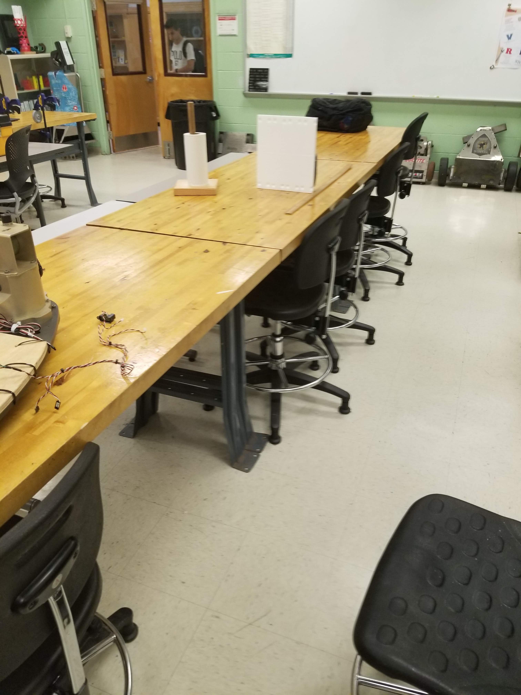
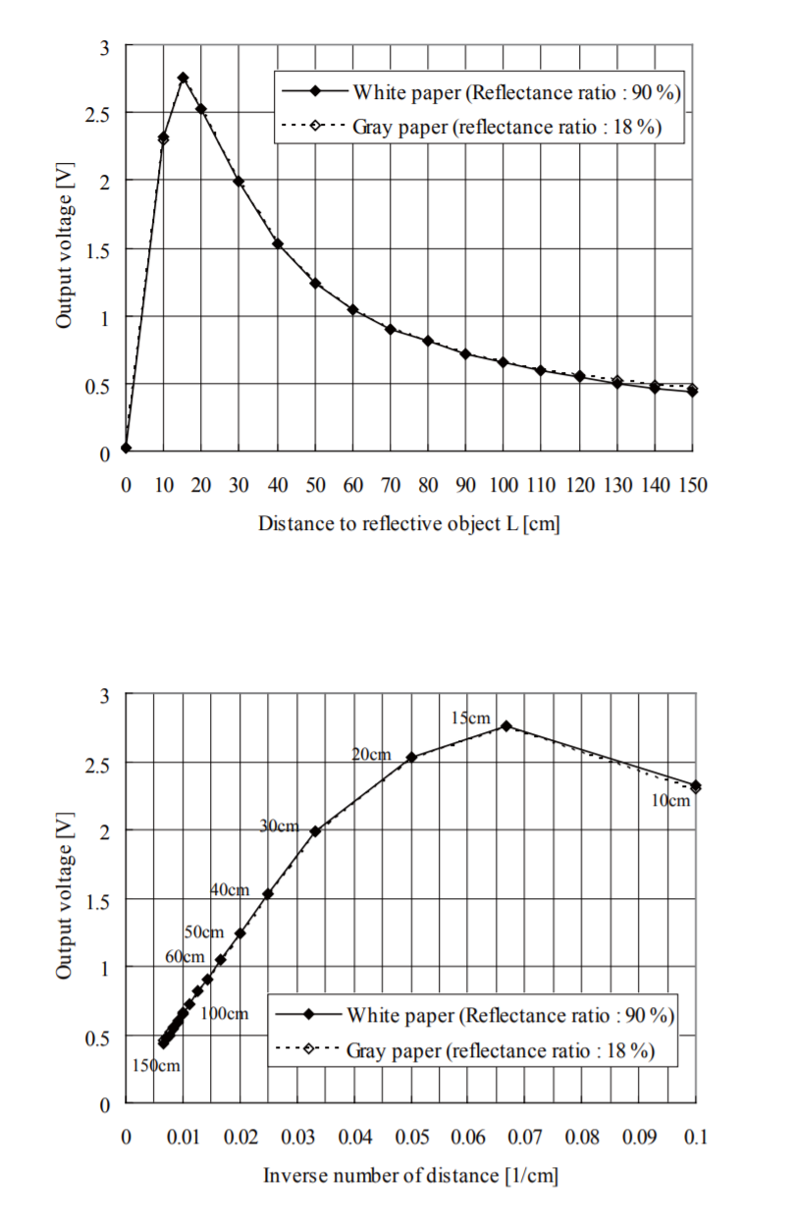
IR distance sensors
Datasheet: https://www.sparkfun.com/datasheets/Sensors/Infrared/gp2y0a02yk_e.pdf
The sensor produces an analog output inversely proportional to the distance, but since there are a total of 19 sensors on board and the Arduino Due only has 12 analog inputs, only 10 of them can be used…(2 pins will be sacrificed for head positioning potentiometers)
20cm to 150cm range
Based off of the experimental data, a function that closely models the curve is Y = 23576x^{-1.134} x = analog value, y = distance

Slide 15
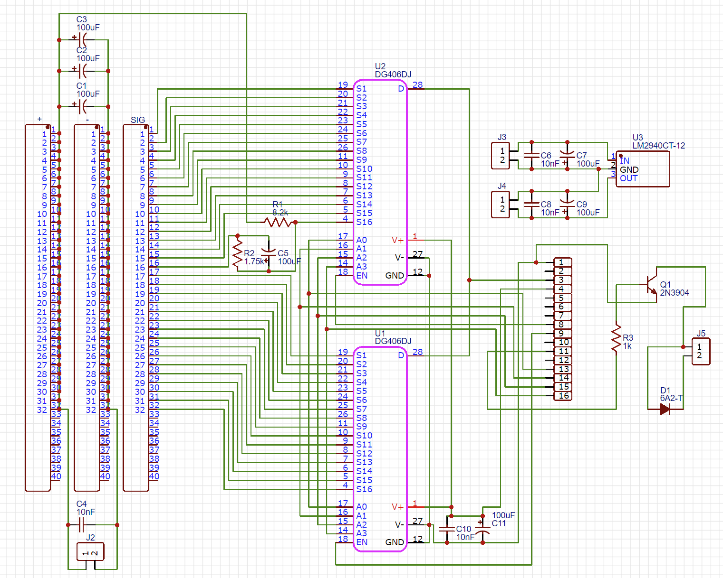
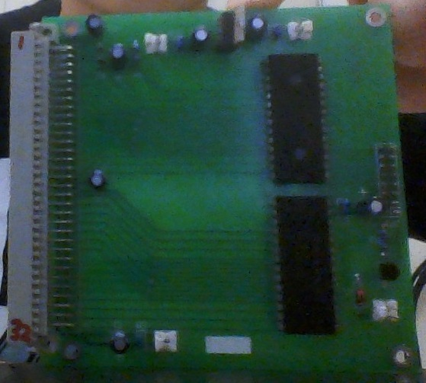
IR sensors continued
I have reverse-engineered and created a schematic of the board I salvaged from the computer. This will allow me to read all the IR sensors with one analog pin

Slide 16
Potentiometers
5 kiloohm potentiometers
With the IR sensors now only occupying one analog pin, both potentiometers can be read. Check schematic v1.2

Slide 17
Update November 27, 2018
I replaced the 24 volt motors with 12 volt motors
I also figured out how to make Rosie move omnidirectionally
I took out an old IR sensor board from the computer that used to be part of Rosie. I hope to reverse engineer the board and take advantage of the hardware like the dual 16 channel multiplexers (Maxim DS406) that will allow me to read all 19 IR sensor values one at a time with one analog pin, eliminating the need for a larger Arduino (Arduino Due)
Datasheet for the 16 channel analog multiplexer is here: https://www.mouser.com/datasheet/2/256/maxim_sf-00086568-1179780.pdf

Slide 18
Drive Base
This is by far the most annoying part of this project….

Slide 19
Rosie’s Capabilities
Due to the unique arrangement of the drive system, Rosie is able to move omnidirectionally: left-right, forwards-backwards, turn in place, make a U-turn, K-turn, do backflips (ok maybe not this one) etc….
However, this also poses some problems
It is very difficult to program movements
It is difficult to maintain without any background knowledge or documentation
The balls are friction-driven, so there is going to be limited traction, efficiency, and ground clearance.

Slide 20
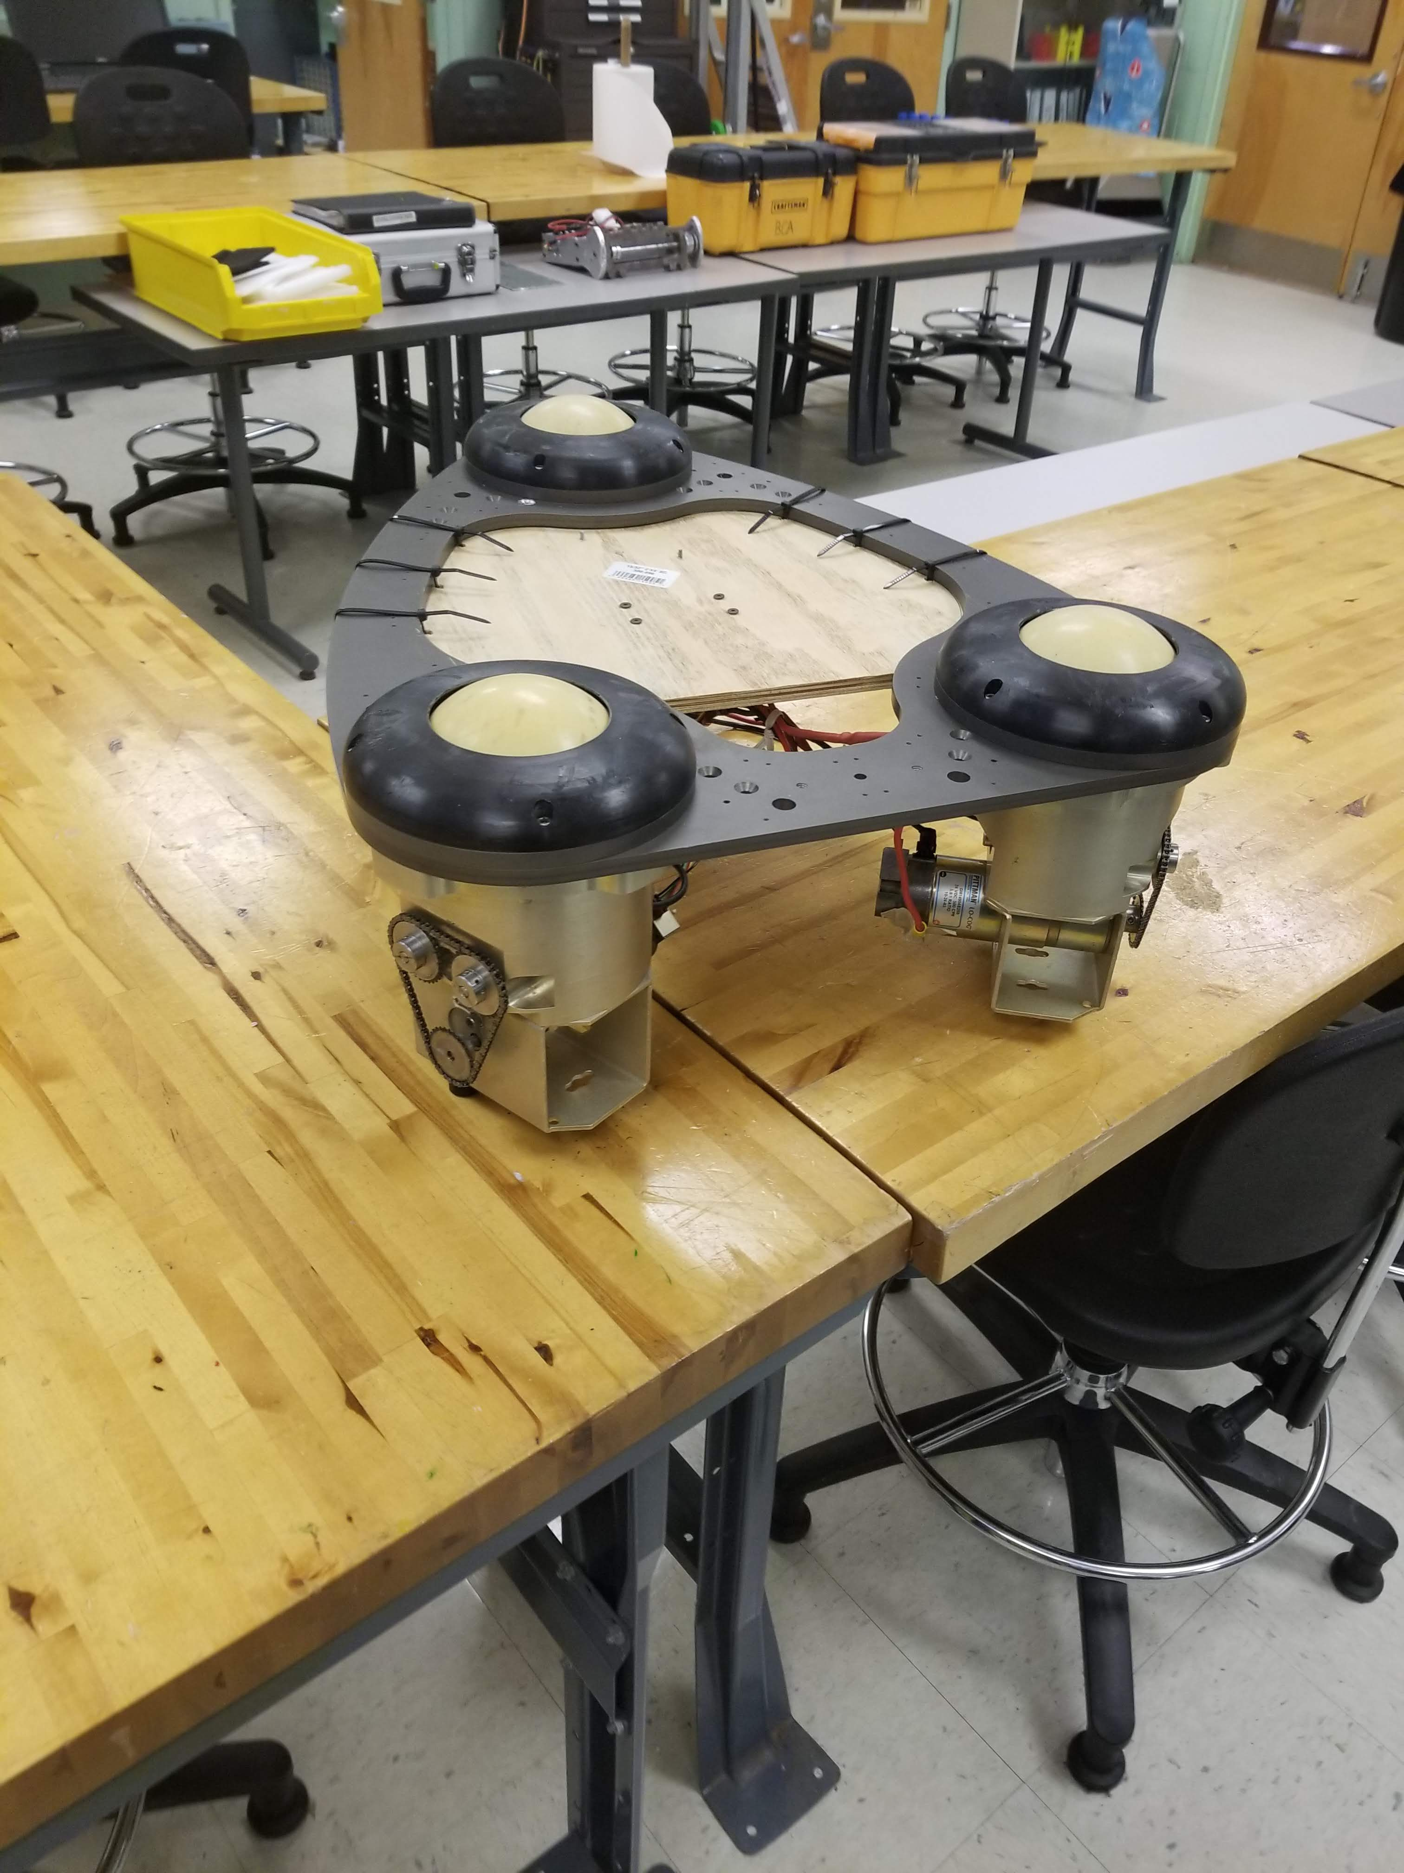
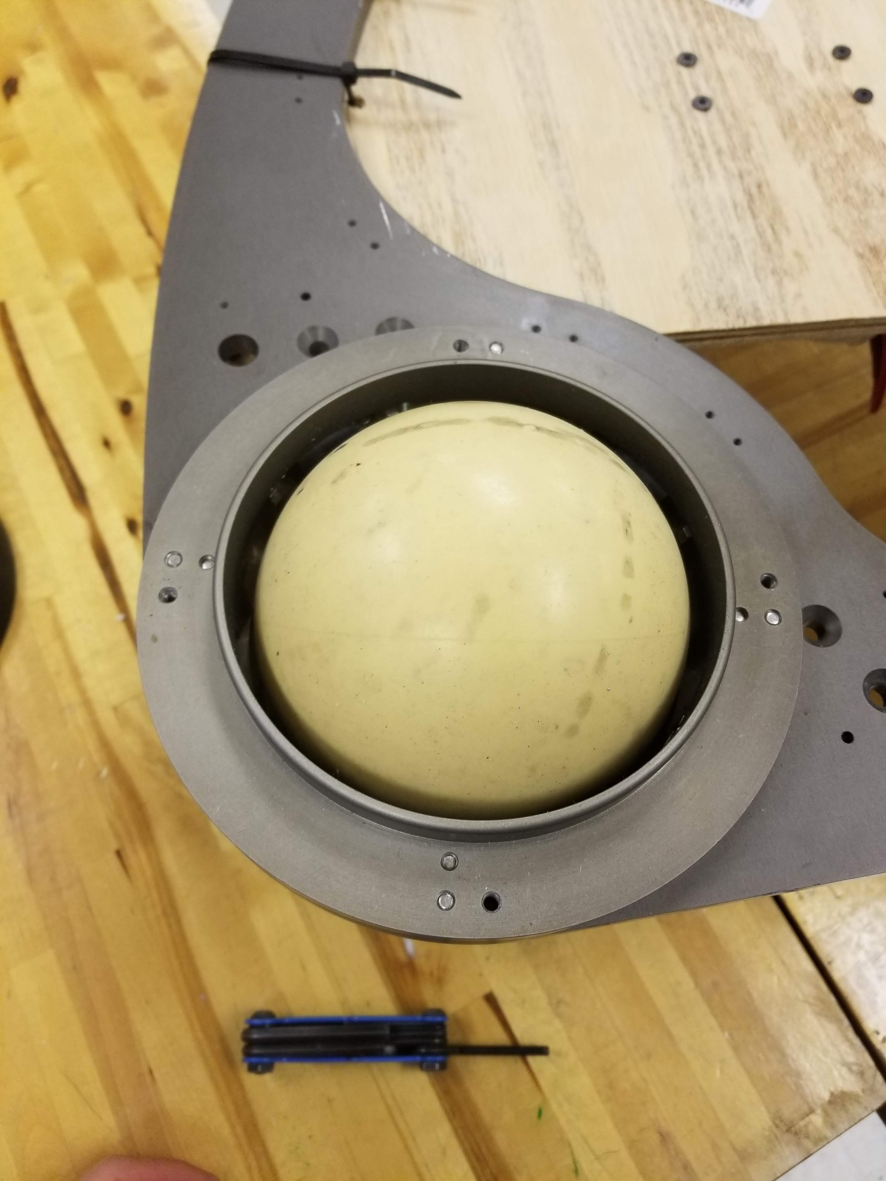
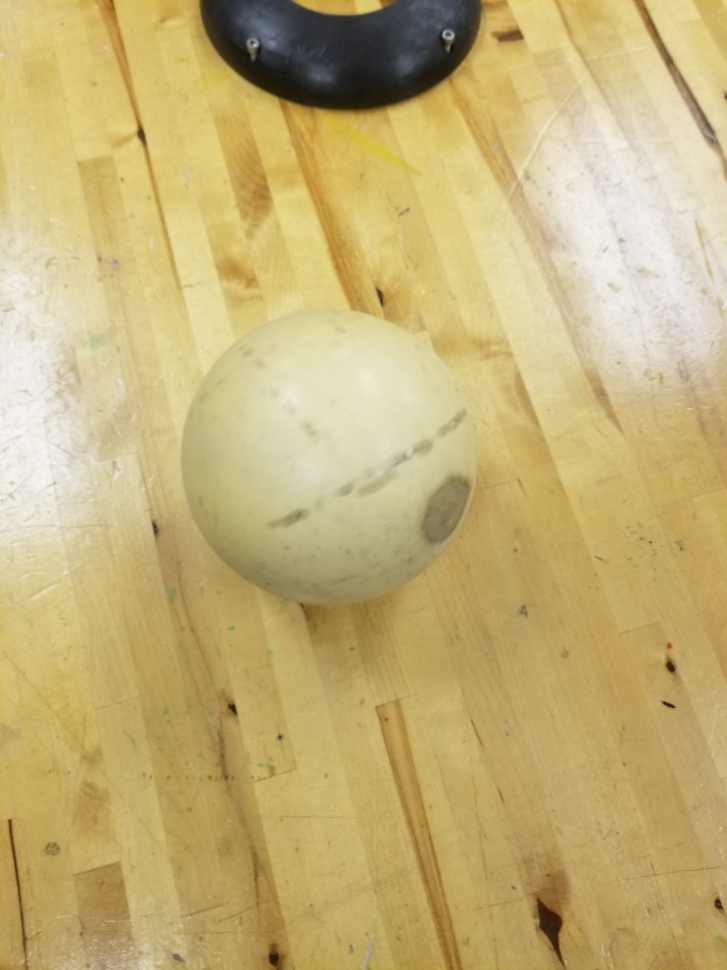
Drive base layout
The drive base is in a shape of an isosceles triangle driven around with three 5 inch plastic-rubber balls:

Slide 21
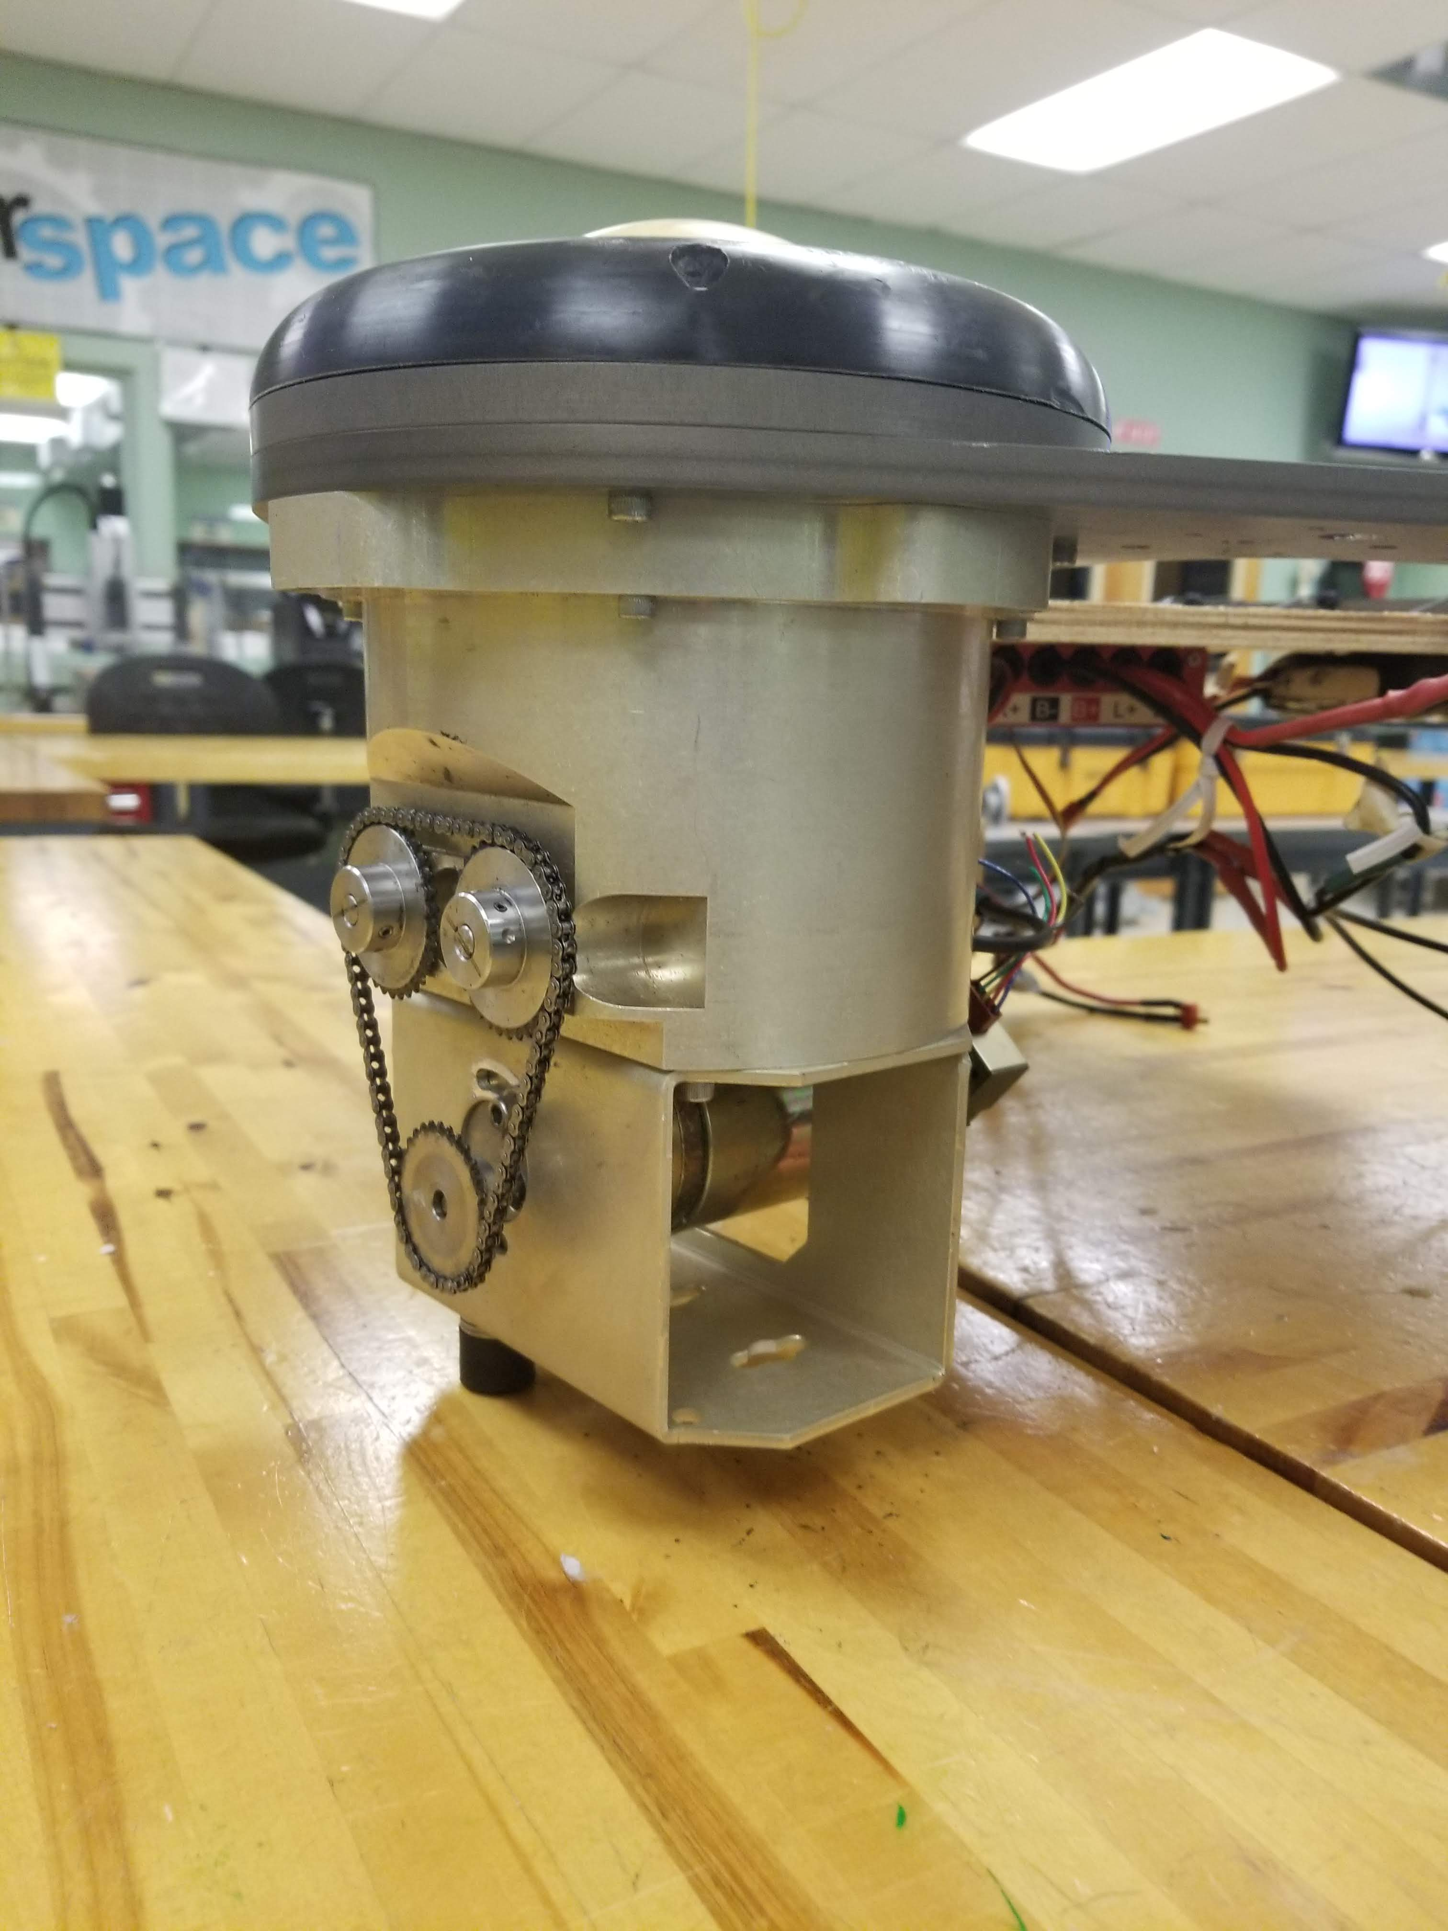
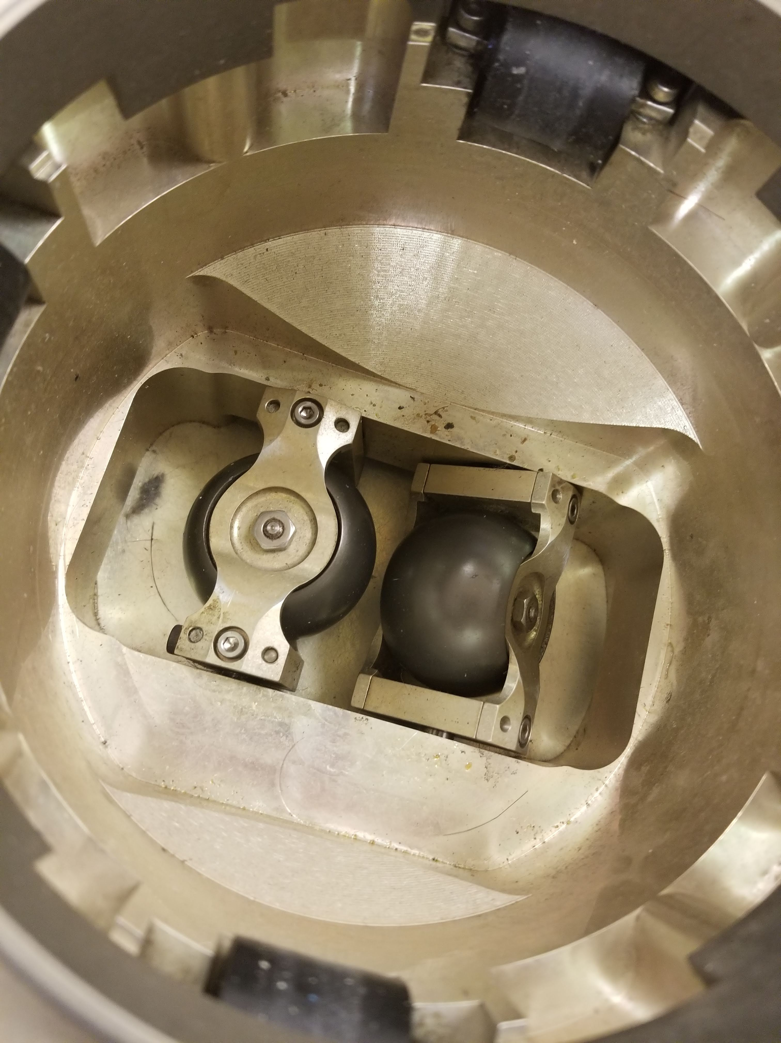
Ball Drive
The motors drive two rollers in one axis while the balls are allowed to free-roll in the axis perpendicular to it.
There is a specific angular arrangement of the rollers, if the rollers are not placed in that specific configuration, there will be a lot of bouncing and vibration, which in the long run, will break gearboxes.
Based off my guesses, the correct arrangement would be to point the lines on the roller gears at the drive gear axle.

Slide 22
More Drive info
The rear left and right motors push Rosie forwards by driving the balls outward at an angle.
The front motor only moves the “nose” of the drive base left and right, and is only needed for turning and moving side-to-side
Command | Left Rear Motor | Right Rear Motor | Front Motor
North-South Linear Motion | Forwards or Backwards | Opposite Direction as Left Motor | Off
Turning in place | Forwards or Backwards | Same Direction as Left Motor | Same Direction as Left Motor
West-East Linear Motion | Forwards or Backwards | Same Direction as Left Motor | Opposite Direction as Left Motor

Slide 23
Rosie gets a face
This section purely focuses on getting an image on the monitor and all head-related information

Slide 24
New Information
I needed to power the monitor, and originally, I unscrewed the “neck” to see where the power wire was located. The wires that came out of the neck were:
VGA signal wire (thick white wire)
Wifi connector (thin black wire)
Audio wire (thin black wire with gold connector)
A yellow and black wire pair (power)
A weird connector (most likely connected to the camera)

Slide 25
Power Problems
NOTE: THE MONITOR DOES NOT RUN OFF OF 120VAC AS I HAD ORIGINALLY PREDICTED!!!
The monitor was originally wired to the output of the computer and a little investigation revealed that the monitor does not directly connect to the 120VAC output of the inverter, rather it gets the power from the computer PSU (power supply unit) at 12VDC.
The solution? I ripped the PSU out of the computer, shorted the green wire to GND (for the PSU to turn on), cut a yellow and black wire and soldered it to a connector which corresponds with the monitor wire connectors.

Slide 26
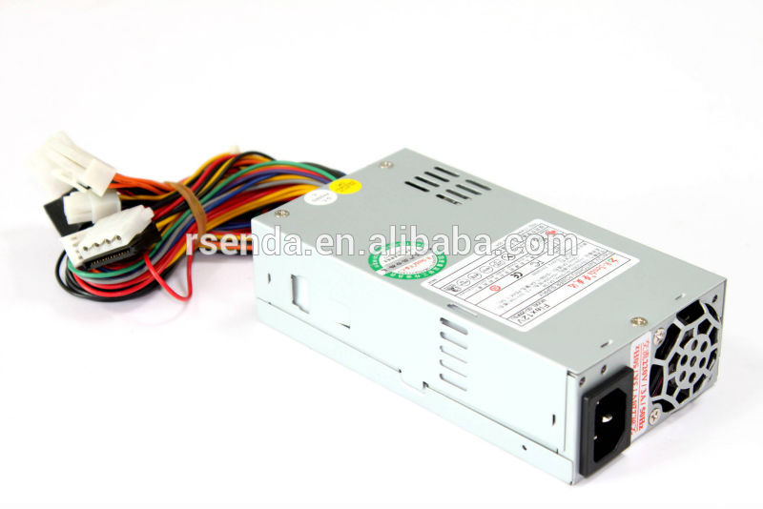
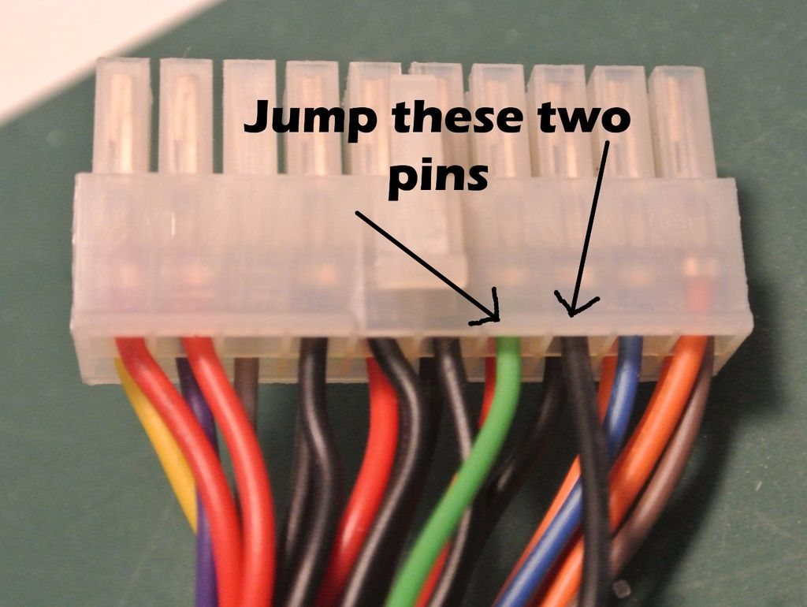
PSU!!
With the PSU mounted inside, I realized that I can use the PSU 5V high-current output to power both the Raspberry Pi and the Arduino and not worry about the BECs not being able to supply enough current.
Look at the updated schematic in the next slide for more information

Slide 27
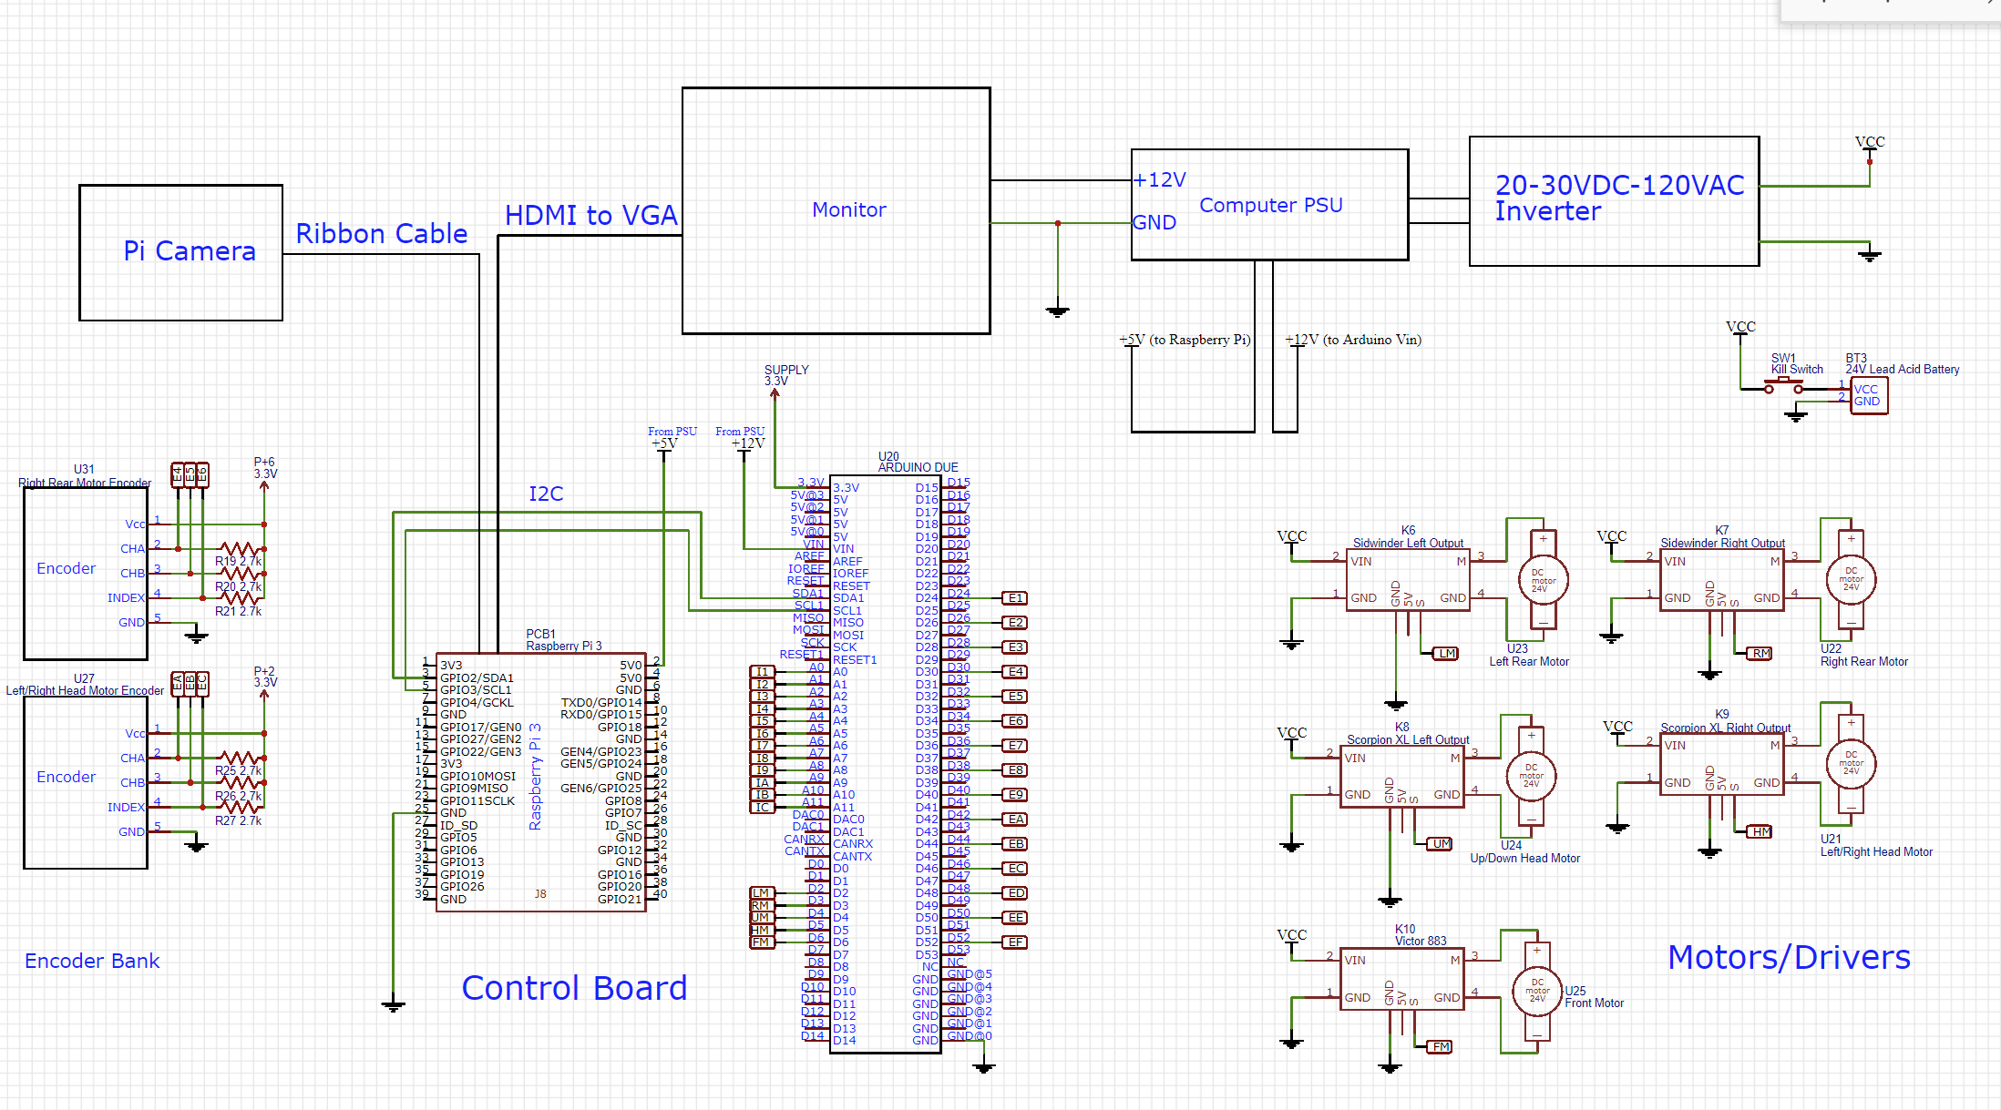
Schematic v1.1
The power for the monitor has been updated and the camera has been opted out for a Raspberry Pi camera instead of the current webcam

Slide 28
Mission Rosie Trimester 2
MOre changes and finalization of drive

Slide 29
Changes
No more motor encoders
Added a relay switch
Wired everything neatly to a board
Used an Arduino Uno instead of Arduino Due (so I can use port manipulation, resulting in faster and more efficient control)

Slide 30
IR board schematic
Pin “one” is the pin with a square solder joint and pin 2 is underneath the pin, goes up until pin 8 (bottom left) then pin 9 (bottom right) and back up to pin 16.
Note: there are at least 4 different independent circuits located on this board….I just included them here for reference

Slide 31
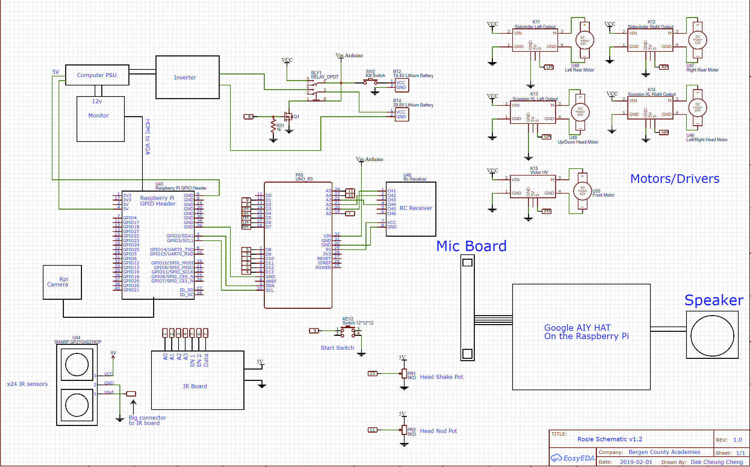
New Schematic (v1.2)
I will need to monitor voltage of the batteries but I do not have enough Analog pins on the Arduino….probably going to use Raspberry Pi to read voltage….

Slide 32
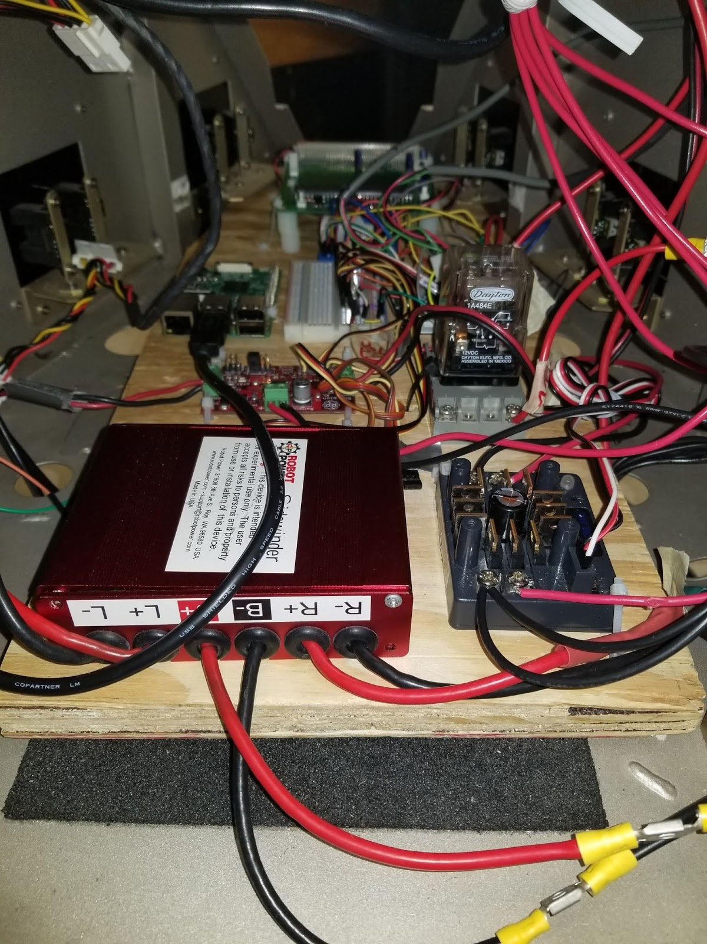
Wood board
I cut a wood board to hold all the electronics securely in place

Slide 33
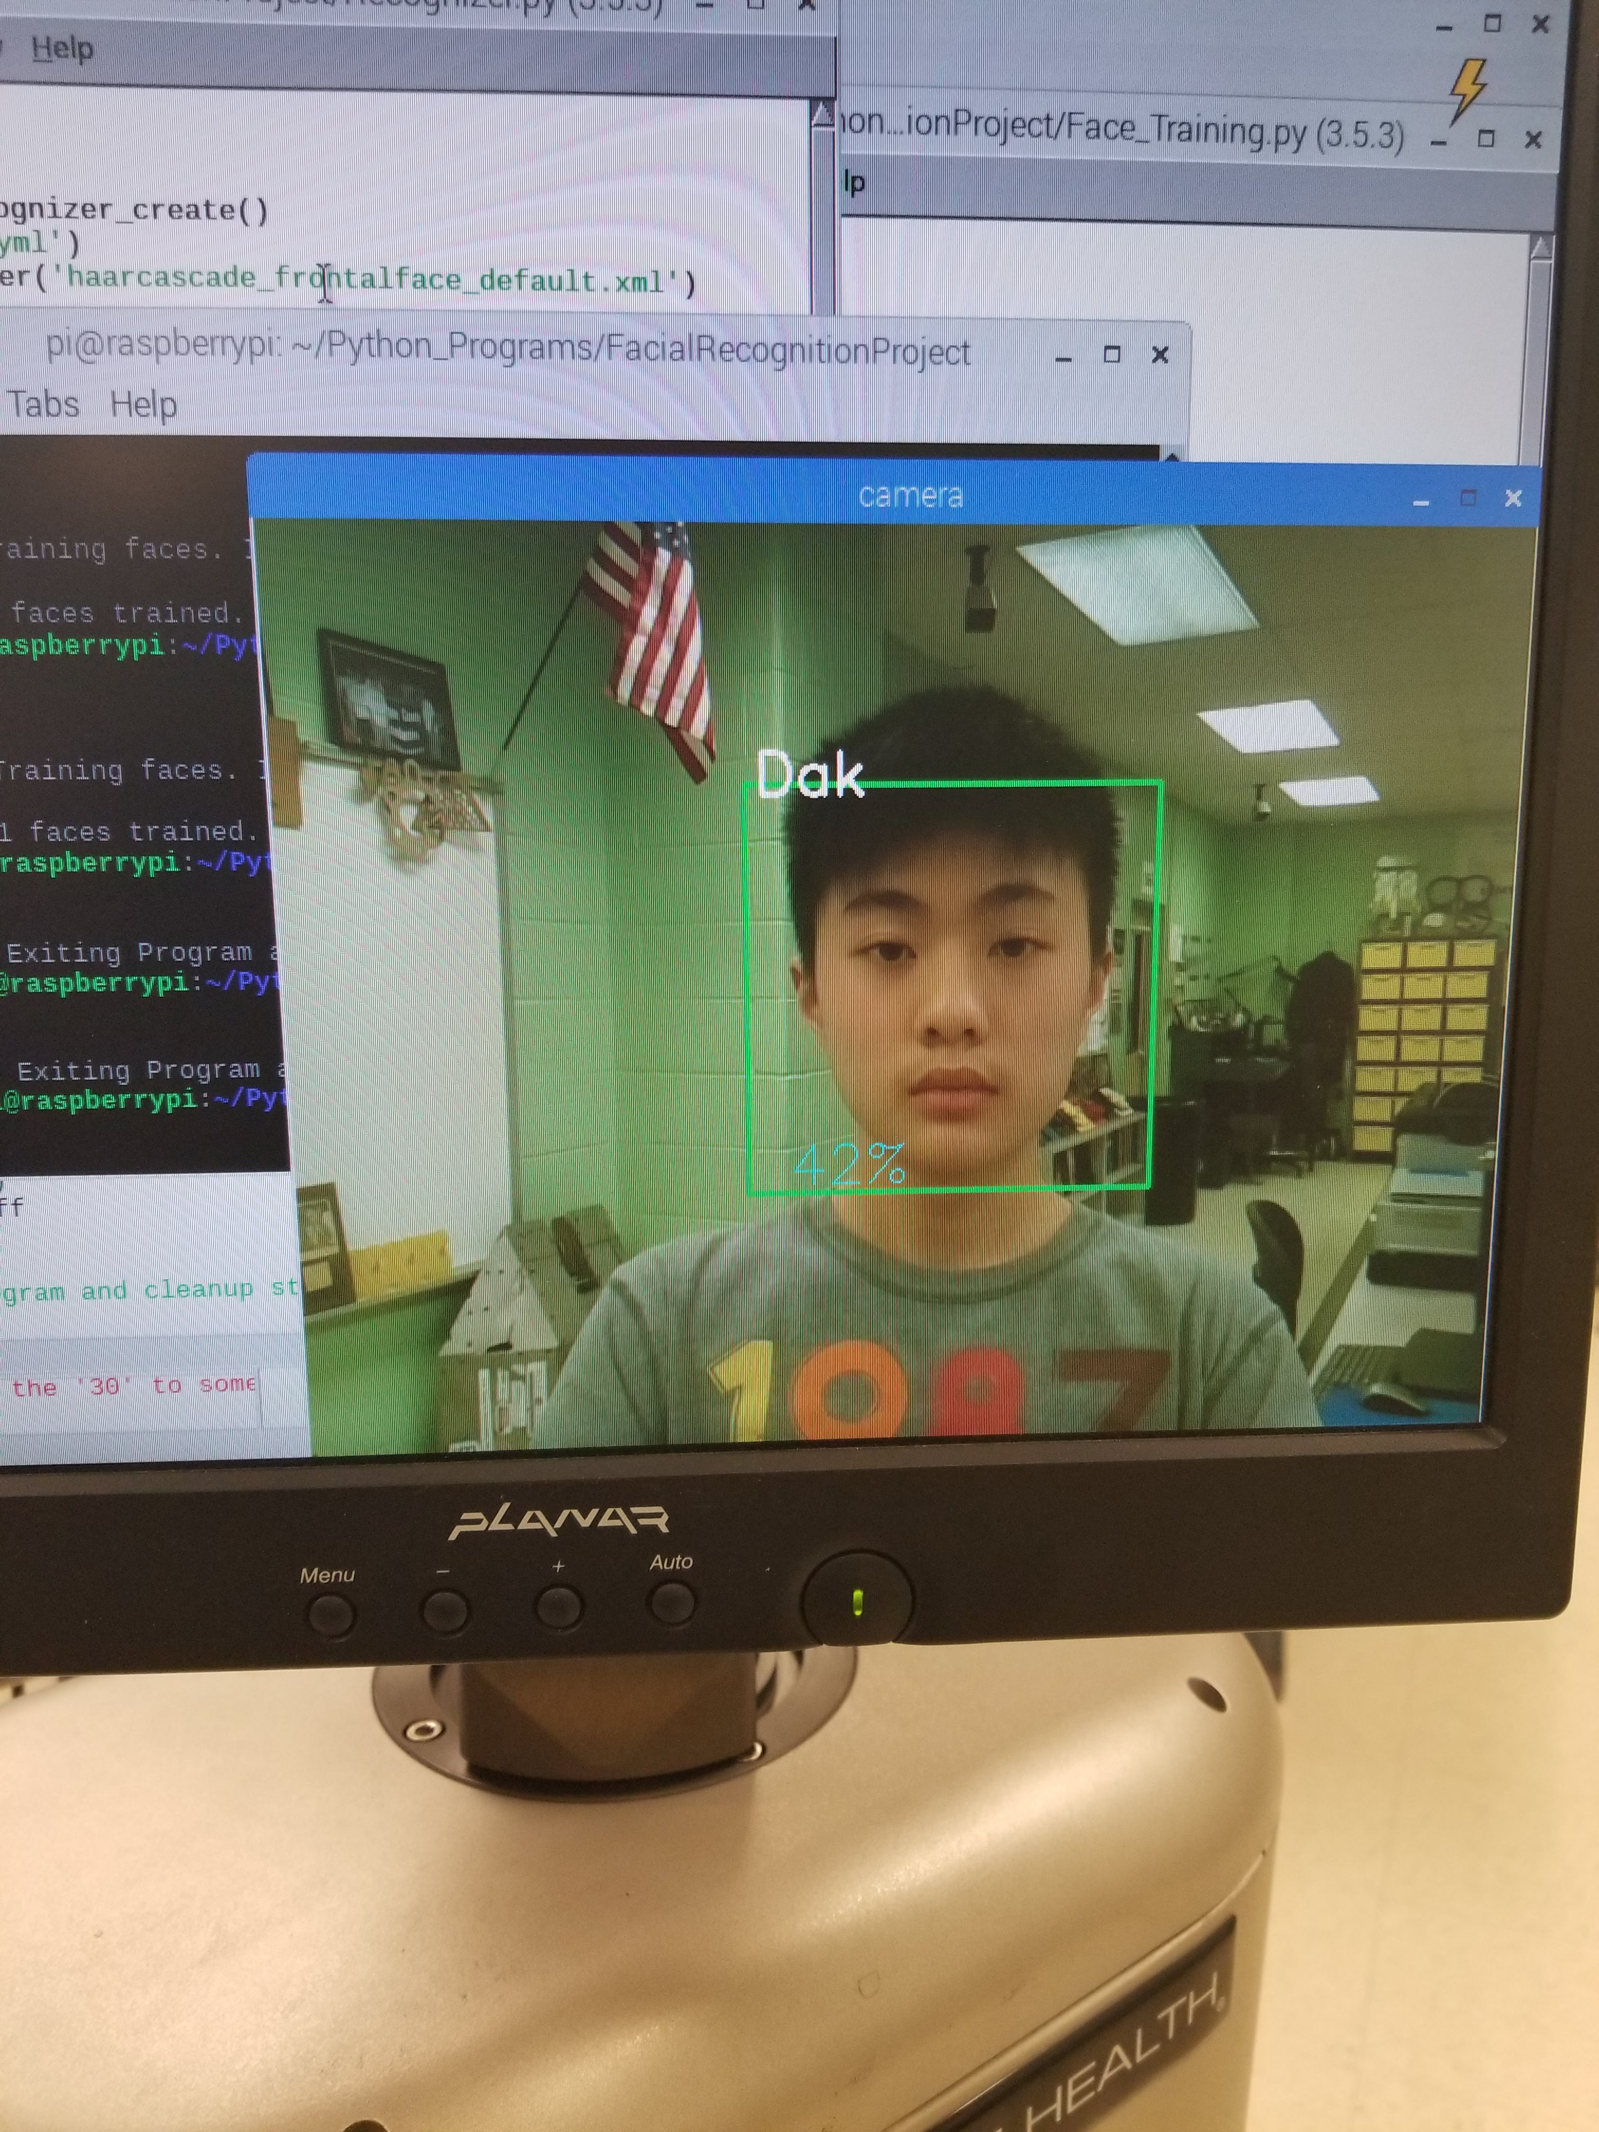
Face Detection
With the Raspberry Pi, I installed OpenCV 4 and a face haarcascade. This enables me to detect faces with the raspberry pi camera.
Facial Recognition:
Rpi takes 30 pictures
Updates a trainer file using the 30 pictures
Stores your name and the face in a file so it can recognize you next time

Slide 34
Research Expo
2nd place in engineering category
Office of Naval Research Award
Demonstrated Face tracking only because….
*NOTE: For future reference, no WIFI allowed during Expo……so all speech processing has to be done locally*

Slide 35
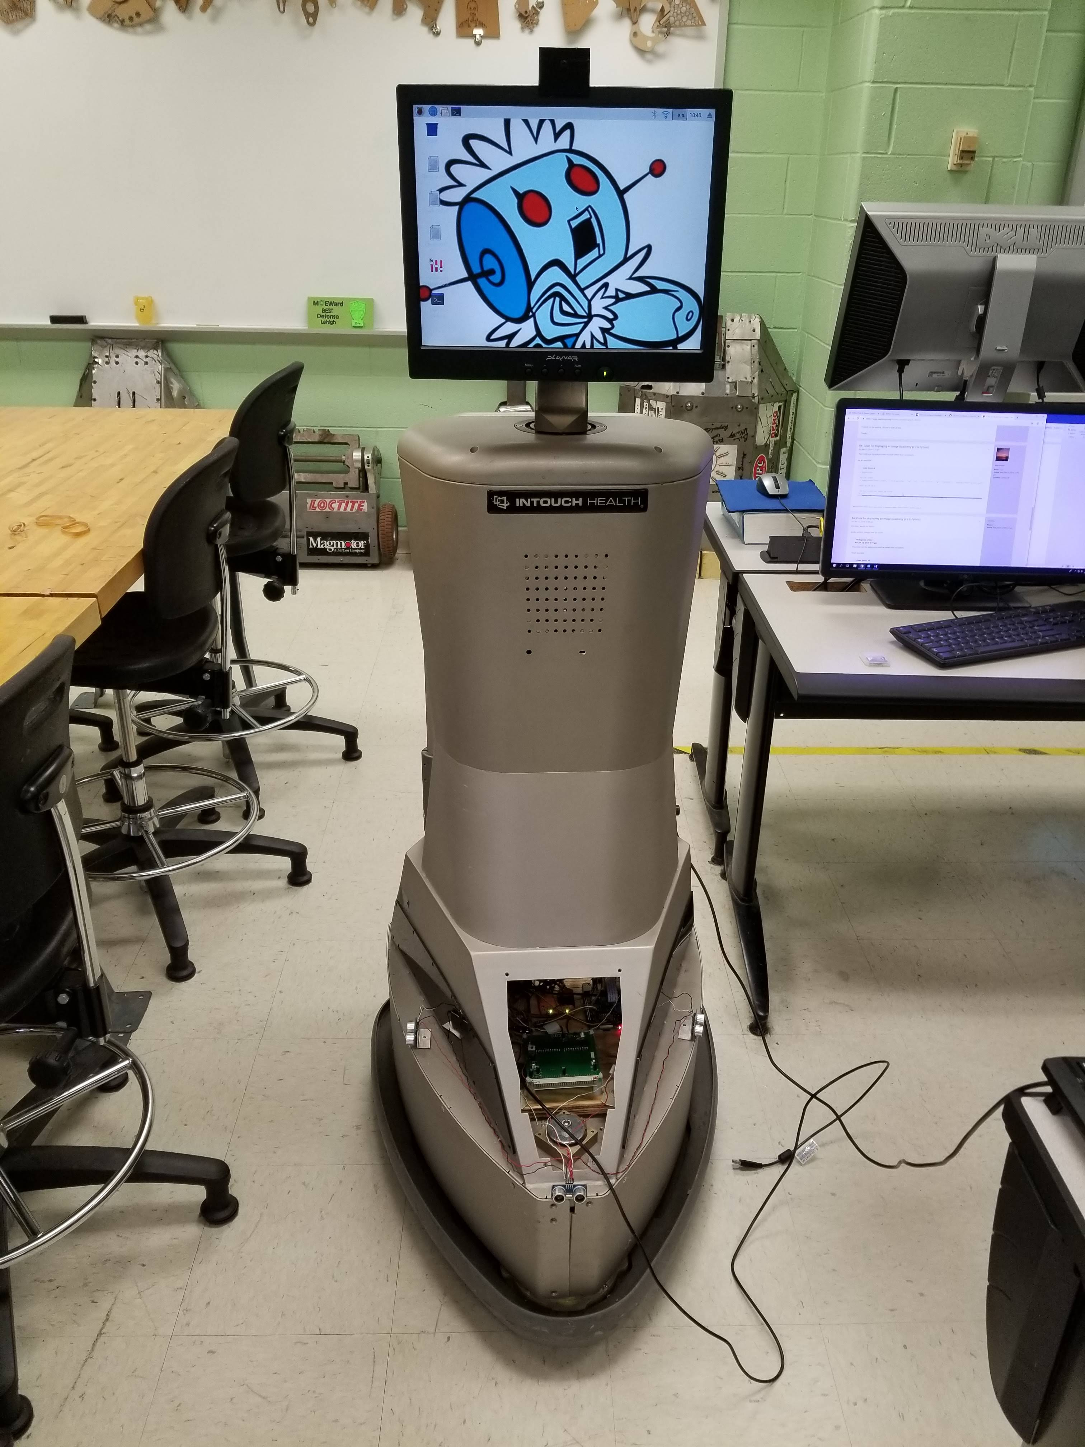
Mission Rosie Trimester 3
Bringing it home

Slide 36
Updates
Gave up on IR sensors, they are wasting too much time and draw too much power (20mA per sensor, ~21 of them)
Used ultrasonic sensors instead (HC-SR04)
Protoboard shield on Arduino to replace breadboard
On/off switch implemented

Slide 37
Protoboard
Hard-wired header pins to dedicated Arduino pins
Added MOSFET circuitry to turn on relay
On/off button circuitry mounted on it as well.
This saves a lot of room, more reliable, and looks neater.

Slide 38
RIP IR sensors
I got rid of the IR sensors as most of them do not function correctly.
Instead, I decided to use 3 ultrasonic sensors, giving it much better functionality.
I wrote a simple test program → drive forwards until there is an object, then stop. When object disappears, continue moving.
Plan to write the final Hallway Patrol program
Rosie will drive in a rectangle in the hallway
She will avoid any object by moving sideways
She will maintain a consistent distance from a wall.

Slide 39
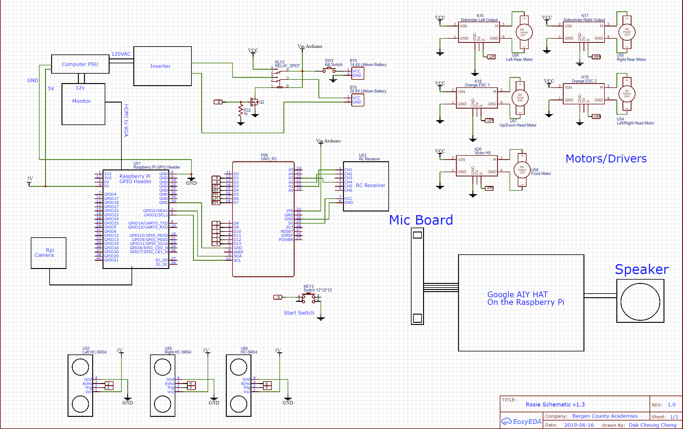
Schematic v1.3
Final iteration of Rosie’s schematic

Slide 40
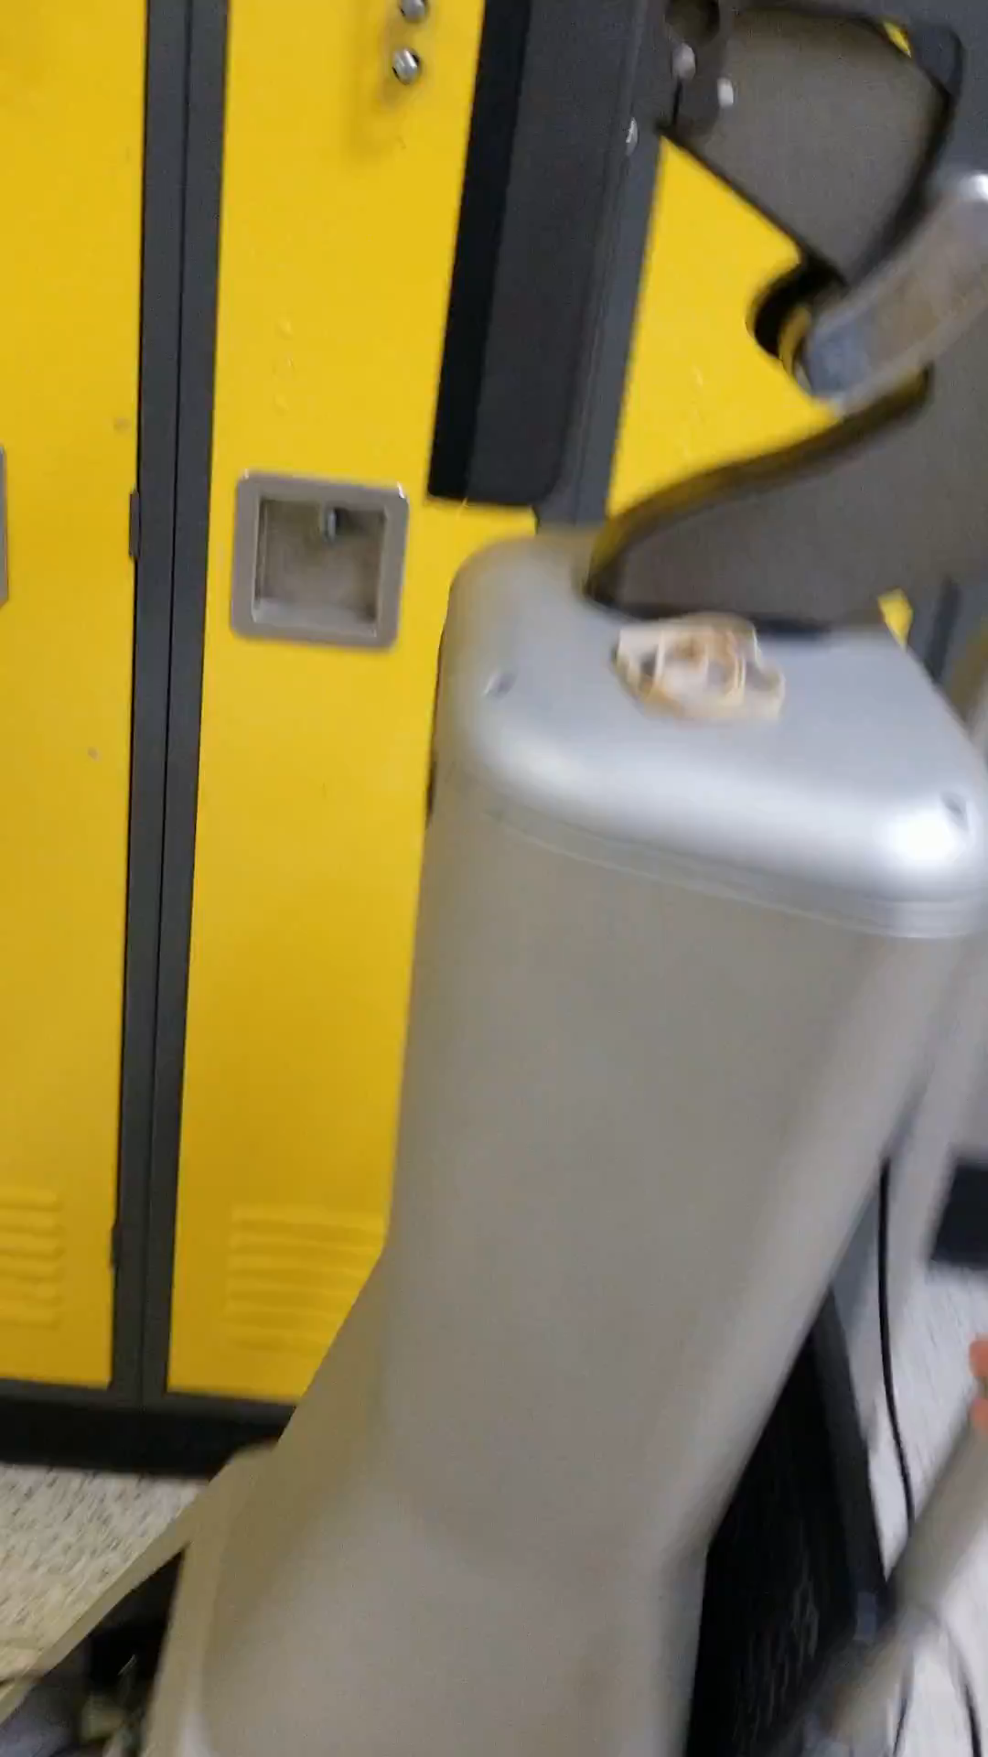
Yayyyyyy!
Rosie Hallway Patrol demo

Slide 41
What I learned
How to design a proper schematic
How to create neat wiring (kinda…:P)
How to document information
How to manage my time

